Slide 1
Best Practices for Migrating From RDBMS to MongoDB
Sheeri Cabral, Product Manager, Distributed Systems
Notes:
This talk will be recorded and a link will be sent out to all participants soon.
Please ask questions in the Q&A not the chat.

Slide 2
Safe Harbor Statement
This presentation contains “forward-looking statements” within the meaning of Section 27A of the Securities Act of 1933, as amended, and Section 21E of the Securities Exchange Act of 1934, as amended. Such forward-looking statements are subject to a number of risks, uncertainties, assumptions and other factors that could cause actual results and the timing of certain events to differ materially from future results expressed or implied by the forward-looking statements. Factors that could cause or contribute to such differences include, but are not limited to, those identified our filings with the Securities and Exchange Commission. You should not rely upon forward-looking statements as predictions of future events. Furthermore, such forward-looking statements speak only as of the date of this presentation. In particular, the development, release, and timing of any features or functionality described for MongoDB products remains at MongoDB’s sole discretion. This information is merely intended to outline our general product direction and it should not be relied on in making a purchasing decision nor is this a commitment, promise or legal obligation to deliver any material, code, or functionality. Except as required by law, we undertake no obligation to update any forward-looking statements to reflect events or circumstances after the date of such statements.
Notes:
This is our safe harbor statement, which mostly just says not to use future facing statements to make decisions about whether to use MongoDB or not. I only talk about current product functionality so this shouldn’t be an issue.

Slide 3
Agenda
Normalization and MongoDB
Schema Design and Performance
Seamless no-downtime Migration
Q&A
60 minutes
Notes:
I don’t want to spend a lot of time on the agenda, but hopefully these topics are what you’re expecting to talk about. We will not be discussing sharding or replication, though I encourage you to learn more about those topics because they are part of MongoDB’s power as a data store.

Slide 4
Who am I?
Notes:
So, who am I? Well, the title slide showed that I’m a product manager here at MongoDB. But why am I giving this talk?

Slide 5
Who am I?
Master’s in Computer Science
Notes:
I earned a Master’s degree in computer science, which I mention because we studied relational algebra and relational calculus, so I have a strong theoretical background for relational systems.

Slide 6
Who am I?
Master’s in Computer Science
Sysadmin for 4 years
Notes:
I was a systems administrator for a few years

Slide 7
Who am I?
Master’s in Computer Science
Sysadmin for 4 years
MySQL DBA for 14 years
Notes:
And then a MySQL DBA for 14 years. I stopped being a MySQL DBA when I became a product manager at MongoDB. Along the way, my jobs have included using and administering Postgres, Redshift, Vertica, Oracle, IBM DB2, Microsoft SQL Server and Sybase. I spent a LOT of time in the relational world, and when I came to MongoDB I had to change how I think about schemas. The biggest hurdle when migrating from a relational system to MongoDB is migrating your schema.

Slide 8
RDBMS = Relational Database Management System
Notes:
Let’s talk about basics - An RDBMS is a relational db management system
MongoDB is not an RDBMS, but it is a System, for Managing Data. It’s just not relational, which means it does not conform to EF Codd’s relational model of data.

Slide 9
Relation = Table
Notes:
A relation is a table. The relational model focuses on each table being an entity type, like a person.
Credit: https://en.wikipedia.org/wiki/Relational_database

Slide 10
Notes:
Here’s an example user table.
Columns are attributes, and a row, also called a record, is one instantiation of the entity – in this case, person. This relation reflects the data that my username is sheeri and my husband’s username is magic Tony. Because he’s a magician.
Now, mongoDB is not a relational database. It’s a document database.
Credit: https://en.wikipedia.org/wiki/Relational_database

Slide 11
row ~ document
Notes:
Instead of rows, it has documents.
Credit: https://en.wikipedia.org/wiki/Relational_database

Slide 12
row ~ document
table ~ collection
Notes:
And instead of relations or tables, it has collections.
Credit: https://en.wikipedia.org/wiki/Relational_database

Slide 13
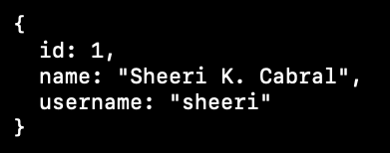
Notes:
This is what the data looks like in MongoDB. The part before the colon, like id and name and username, is the JSON key. What we called a table row, or a record, is everything within the set of curly braces, or a document.
Credit: https://en.wikipedia.org/wiki/Relational_database

Slide 14
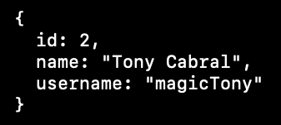
Notes:
The same data is reflected here as in the relational table. These 2 rows correspond to 2 documents. This person table with 2 rows in a relational database turns into a person collection with 2 documents in MongoDB.
Things get more interesting when we add in other information.

Slide 15
Notes:
For example, if we wanted to model a person’s blog posts, in a normalized relational schema we would have another table called articles, that had article details and an author id that we could use to join with the person table.

Slide 16
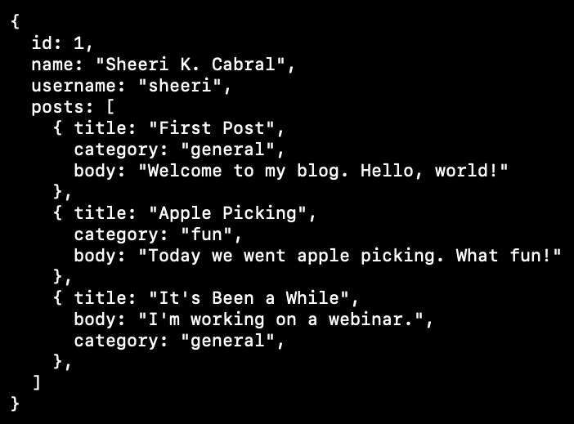
Notes:
This is what that data looks like in MongoDB. There is one document for a user, which contains an ARRAY of posts, with titles, categories and text for each post.
Embedding the data in a document is one way to handle a one to many or even many to many relationship in MongoDB.

Slide 17
Notes:
Here’s another document in the same collection. Remember that a document is analogous to one row of a table in a relational model, and a collection is analogous to a table.
Tony’s document has an array of posts just like my document does. Note that he does not have categories like I do. MongoDB’s flexible schema gives you the power to have documents like this, where the fields don’t have to be exactly the same. This is called a polymorphic design pattern.
Additionally, as a best practice, data that is accessed together is stored together. This makes retrieval faster. So when we are looking for all of my posts, they’re all in the same document.
Now, we wouldn’t do this in a relational system, because of normalization.

Slide 18
What problems does normalization solve?
Notes:
Let’s talk about normalization. Normalization exists because without it, there are problems.

Slide 19
What problems does normalization solve?
Hard to update a multi-value data cell
Notes:
1st Normal Form exists because it’s hard to update multiple values in one cell. I’ve worked in places where developers use a relational database and put multi-value XML or JSON in a row, and then have to parse that all out.

Slide 20
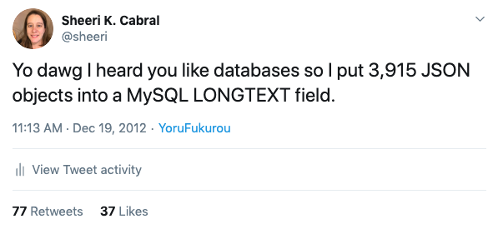
Notes:
Back in 2012, I tweeted, “yo dawg, I heard you like databases, so I put 3,915 JSON objects into a MySQL LONGTEXT field.” 1st normal form is meant to eliminate that problem, and a schema that includes this isn’t normalized. With MongoDB, we’ve seen that we can have arrays natively, so it’s not a problem to update a multi-value cell. 1st normal form doesn’t really apply to mongodb.

Slide 21
What problems does normalization solve?
Duplicate data leads to data integrity problems when doing updates
Hard to update a multi-value data cell
Notes:
2nd and 3rd normal forms are about dependencies – changing the data in one place only and minimizing duplicate data.

Slide 22
What problems does normalization solve?
Duplicate data leads to data integrity problems when doing updates
Hard to update a multi-value data cell
Duplicate data wastes resources
Notes:
When you have duplicate data you need to make sure it stays in sync, and that wastes resources.
So, normalization solves problems relating to data integrity and wasting resources.
Normalization is a concept applied to relational databases, so it doesn’t make sense to talk about normalizing MongoDB.

Slide 23
Notes:
It’s like saying a relational database is an orange, and to get to the part you can eat, you peel it.

Slide 24
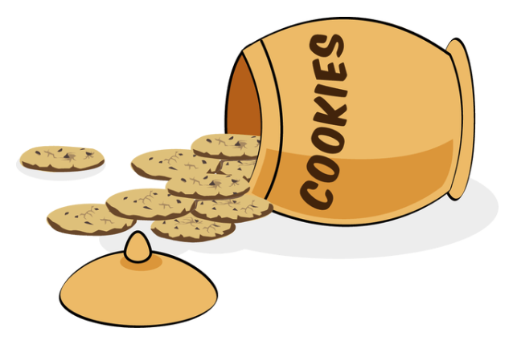
Notes:
MongoDB is like a jar of cookies – you don’t peel a jar of cookies, you open it up. The end result is you get to the part you can eat, which is what we care about. So you can’t really talk about normalizing a mongodb schema because normalization only applies to relational databases. Normalization isn’t the issue, data integrity and reducing waste are.
I will show how you can create your MongoDB schemas to solve the same issues that normalization does.
Before we do that, though, I want to acknowledge that normalization solves some problems, but creates others. And this is why we denormalize.

Slide 25
What problems does normalization cause?
Notes:
In an ideal world, a relational database would be normalized to 3rd normal form. Normalization is great for data integrity and consistency, but isn’t always the best for performance.

Slide 26
What problems does normalization cause?
Transactions
(ACID compliance) more difficult
Notes:
More tables means you have to figure out how to update data atomically, consistently, at the right isolation level, and durably. It’s easy enough to lock a whole row or a few rows without causing too many issues, but it’s harder to have to lock multiple tables without causing lots of performance issues.

Slide 27
What problems does normalization cause?
Transactions
(ACID compliance) more difficult
Joins are expensive
Notes:
Also, Joins are expensive. In my career as a DBA, I made lots of tradeoffs for denormalization, usually to increase performance. Wikipedia even says “Denormalization is a strategy used on a previously-normalized database to increase performance.”
You can denormalize by having redundant data, for example, a user table might have a “last logged in” time, so that when you log in, your last login time can be displayed without having to do a join.
Credit: https://en.wikipedia.org/wiki/Denormalization

Slide 28
What problems does normalization cause?
Transactions
(ACID compliance) more difficult
Joins are expensive
Migrations are not convenient
Notes:
Another reason to denormalize in the relational world is when you want to add a field to an existing table, but the table is large and you cannot afford having that table locked while it adds the column. So instead of having a migration with downtime while the table is locked, you denormalize and make a new table so you don’t have to have that downtime.
Credit: https://en.wikipedia.org/wiki/Denormalization

Slide 29
Notes:
Looking at this document again, we can see that there’s no duplicate information. Each post is associated with the same person, by EMBEDDING the post information into the person’s record. This is one way in MongoDB to model the familiar one-to-many relationship – one person may have many posts.
If the person’s username changes, we only update it in one place, and yet we can get a person’s username and posts easily. It’s fast, because it’s all in one place.

Slide 30
Data that is accessed together should be stored together
Notes:
This is a best practice in MongoDB – data that is accessed together, is stored together.
This schema embodies the SPIRIT of normalization because there’s no duplicate data.
With a relational system we have to choose between fast performance and no duplicate data, but in MongoDB we don’t need have that tradeoff between speed and data integrity. We can have the best practice for speed and the best practice for data integrity, we don’t have to compromise.
So, does this mean we should only ever have one collection of documents for all our information?

Slide 31
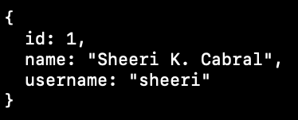
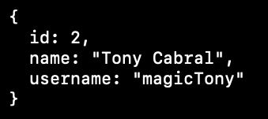
articles
users
Notes:
Of course not! Here, we have split up the documents. The documents on the left are part of the “users” collection, as they were before. The documents on the right are part of a new “articles” collection. We have split up the user information and the posts.
The documents on the right, in the articles collection, store the categories for each post.
The way the data is right now, there’s no clear reason why we split this data up. However, let’s add in some more data.

Slide 32
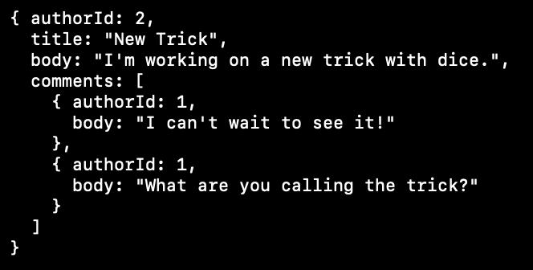
articles
users
Notes:
In the document on the right, we’ve added an array of comments. Now you can see that the reason we split up the data is so that we can separate the users. A user can author an article, and a user can author comments on the article.
In the model shown here, there is still no duplicate information. I wish I could give you a hard and fast rule that says embedding eliminates duplication. But sometimes embedding creates duplication.

Slide 33
articles
users
Notes:
What if we decide to embed user records IN the article collection? For example, what if we put name and username instead of the authorId? Well, I made 2 comments on this particular article. If we embedded my information into each comment, we would duplicate my information.
So embedding might deduplicate data, such as embedding comments in articles, or it might duplicate data, such as embedding the author information in the comments. Normalization in the relational world has strong mathematical models behind it, but achieving those goals in the MongoDB world is part science, part art.
We can’t just say “if you have a 1:many relationship, the best practice is to embed” because that’s not always the right choice. Sometimes, having a reference is the right choice.

Slide 34
// Get the user object
> user = db.user.findOne({username: “sheeri”});
articles
users
Notes:
To do a reference, here is what your code would look like. First, you’d get the data related to the user.

Slide 35
// Get the user object
> user = db.user.findOne({username: “sheeri”});
// Get all the articles linked to the person
> myArticles = db.articles.find({_id: {
$in : people.articles.map(authorId => user._id) } } )
articles
users
Notes:
Then, you would look up the article information for that user. There is no join within MongoDB, your application takes care of that.
You might be thinking, I don’t want the join to be in the application, we try to avoid this in the relational world. And that’s completely valid, to not want to have to do 2 separate trips to the database.
Let’s say I login to this application, post a new article, and then look at all the posts I’ve done.

Slide 36
// Get the user object
> user = db.user.findOne({username: “sheeri”});
articles
users
Notes:
On login, the client does the first query to get my user object. But I have done other stuff using that information – I made a post.

Slide 37
// Get the user object
> user = db.user.findOne({username: “sheeri”});
// Get all the articles linked to the person
> myArticles = db.articles.find({_id: {
$in : people.articles.map(authorId => user._id) } } )
articles
users
Notes:
Then when I want to look at all the articles I’ve posted, THAT’S when it does the second query. In this way, trips to the database are minimized, because you get data when you need it. The user’s id was already accessed, so when it comes time to find all the posts by that user, you only need to query the database once, to find all the articles by that user.
In the relational world, a table is used as a bunch of related data to one PART of an object. In the MongoDB world, best practice for document schema is closer to the whole object itself, not just one part of it. In this example, a user is one object and an article with optional categories and comments is another object.

Slide 38
Model the objects that your application uses
Notes:
One way to think of the best practices for MongoDB schema is to model the objects that your application is using. In our case, our application is using an article object as the main object, so we can try to embed most of the information in an article collection.

Slide 39
articles
users
Notes:
This document uses embedding to model a 1 to many relationship – 1 article, many comments. We could also easily have a many to many relationship with multiple authors on a post. And all we would have to do is have an authors array instead of an authorId field.
In the relational world, we use normalization as a short-hand for how to build a schema with fewer problems. MongoDB does not have such a short-hand, but we do have guidance on how to model your data, which is what I’m talking about when I talk about best practices.
Here’s something to think about:
What if we embedded duplicate information?

Slide 40
articles
Notes:
For example, we have the authorId here but we’re also storing the authorUserName.
Using the best practice “data that is accessed together should be stored together”, a bit of duplication isn’t necessarily a bad thing. It may seem like a lot of duplication here, but it saves a ton of lookups. We are displaying the username with the comment in our app. It’s VERY frequent that you’d want to lookup the author’s username, and it’s rare that an author would change their username. If we need to look up other author information, like the author’s full name or a list of their posts, we can use the authorId.

Slide 41
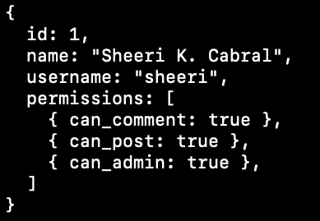
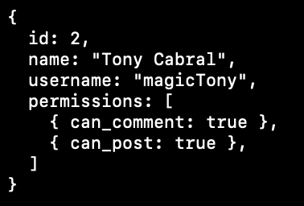
users
articles
Notes:
Here you can see that I’ve added more to the user document. Now there is a permissions array. In our previous example and in the relational world, we referenced a user with one attribute – the authorId.
Here, we reference a user with more than one attribute – authorId and authorUserName. The embedded information in the article does not reference ALL the information stored in the user. It references exactly what will be used. We talked about how, with a reference, you aren’t really doing two database trips at all. You’re getting the user information on login, and then later on, the application joins that information with the reference when retrieving an article and its comments.
In this case, the application does not even have to do that work, because the user name is right there. It only does the work in the rare cases when other information is needed.

Slide 42
users
articles
Extended reference
Notes:
This is called an “extended reference” design pattern, and it’s super useful in MongoDB. The cost of updating all the userName values when the username changes looks like it might be large, but because it happens so infrequently, it’s minimal compared to all the work saved at not having to do so many lookups.
Now, I want to talk about lookups and references in MongoDB. My examples so far have used a numerical, monotonically increasing ID. MongoDB actually GIVES you a unique document identifier.

Slide 43
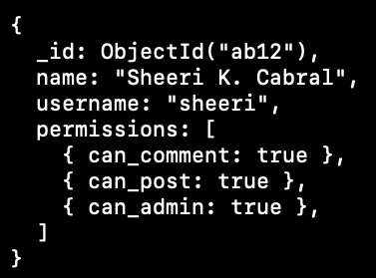
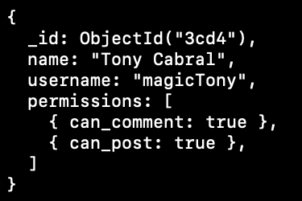
users
Notes:
In reality, the user collection would be made up of documents that look like this, with an object ID automatically created by MongoDB.
You get this _id for free with MongoDB, and it is indexed. You do not have to set up your own sequence or use an auto increment field like in the relational world. If you want to, you can set _id to whatever you want, but it must be unique or you will get a duplicate key error.

Slide 44
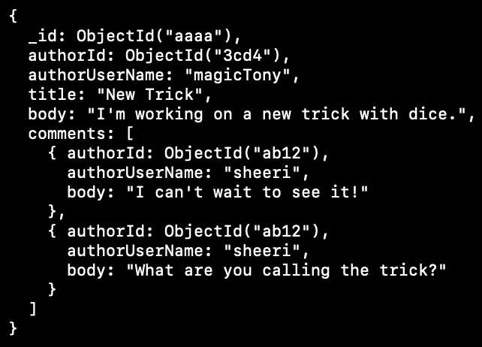
users
articles
Notes:
And the articles collection would have documents that look like this: each article or comment storing the object ID for the user in the appropriate place – under the article itself, or within a comment.
And of course the article itself has an objectId.

Slide 45
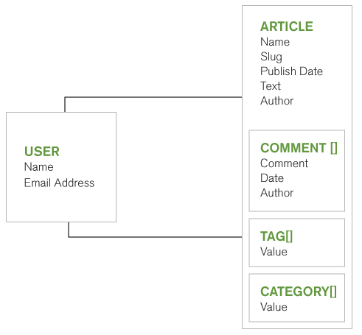
MongoDB
Notes:
I want to visualize what we’re talking about here. This is what our MongoDB schema for an article might look like – one collection for the user information, including name and email address, and additional fields like permissions.
And a second collection for the article itself, with embedded comments, plus tags and categories. My examples didn’t show tags and categories for space reasons.
Getting a list of all tags or all categories does not happen as often as displaying an article, so the tag and category data does not need to be separate. User data is separate, because we want to be able to access it easily when a user logs in. So, that’s in its own collection, and this reflects that a user can author articles and comments.

Slide 46
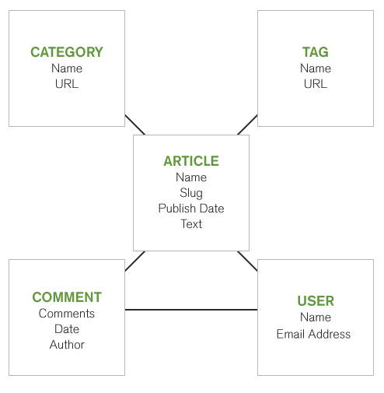
Relational
MongoDB
Notes:
Here we see a relational schema for the same idea – we have 5 tables. The article table is referenced by the other 4 tables, and a user can author articles and comments. This is a normalized schema, something we’re very familiar with.
In the relational world, we join for everything. In the MongoDB world, using an extended reference design pattern, we do not need to do any lookups. But even if we did not use that design pattern, we would still only be looking up comment authors, and eliminating lookups for categories and tags.
Most of what we are querying and displaying is articles and comments, so in MongoDB we want them to be stored together.

Slide 47
Data that is accessed together should be stored together
Notes:
Because data that is accessed together should be stored together. I’ve said this a lot but it’s a really important point.

Slide 48
Relational
MongoDB
Notes:
Back to these diagrams: article, comment, tag and category represent both 1:many and many:many relationships, but it’s completely fine in MongoDB to embed all that information in the article document.
This is where MongoDB schema becomes part science, part art. The best schema depends on how you’re going to query the data, which is not the case for the relational world. Because you want to store data together that is accessed together, you have to KNOW what is accessed together. There’s no ‘best practice’ for how to model a group of related objects because it depends not just on how they’re related, but on how they’re used.
In MongoDB, a good schema has a lot fewer references than a good relational schema. If you find yourself writing a lot of references and lookups, revisit the best practice of storing data together that’s accessed together and revise your schema.

Slide 49
Relational
MongoDB
Thinking in Documents
https://www.mongodb.com/blog/post/thinking-documents-part-1
6 Rules of Thumb for MongoDB Schema Design
https://www.mongodb.com/blog/post/6-rules-of-thumb-for-mongodb-schema-design-part-1
Notes:
There are a lot of great resources to help you out. I recommend these blog posts to start out with. Remember that these slides are available and the links will be there, so don’t worry about writing those links down now.
The mongodb documentation has a whole section on “data models” which includes how to embed and reference data, with lots of examples and patterns.

Slide 50
Relational
MongoDB
What about indexes?
Notes:
I want to look at this slide just a little bit longer because I want to talk about indexes. Indexes in the MongoDB world are just like indexes in the relational world – they cause more work to be done on writes, in order to make reads, sorts, references and lookups faster.

Slide 51
Relational
MongoDB
index
index
index
index
index
What about indexes?
Notes:
In the relational model, we would have indexes on all the id fields of these tables. The article table would contain ids that reference the user, category, and tag tables, to be used in joins. The comment table would have ids that reference the article and the user that authored the comment. And that’s in addition to any other indexes, such as an index on the article’s publish date so that a site can show posts in order of most recent to least recent.

Slide 52
Relational
MongoDB
What about indexes?
Notes:
In the MongoDB model, we do not need all those indexes for fast joins, because instead of having to join 5 tables to get all the data we need, we only need to access 2 collections. Indexes on each collection’s _id and the publish date means that the mongodb model only has 3 indexes, not 6 like in the relational model. Fewer indexes means less overhead from indexes.
When migrating from a relational schema to MongoDB, it is very tempting to just translate each table to one collection, but you will achieve much faster performance with fewer resources if you can avoid that trap. It really is a best practice in MongoDB to design your schema as the objects they represent, and not to just translate each table in a relational DB to a corresponding collection in MongoDB.

Slide 53
What about indexes?
Notes:
MongoDB allows indexes on a

Slide 54
What about indexes?
simple = single field
Notes:
Single field, or

Slide 55
What about indexes?
simple = single field
compound = multiple fields
Notes:
Multiple fields, just like in relational databases.

Slide 56
What about indexes?
simple = single field
compound = multiple fields
multi-key = index for arrays and nested arrays
Notes:
There are also multi-key indexes, which make querying arrays efficient, whether the array contains scalar values or more arrays or sub-documents.

Slide 57
What about indexes?
simple = single field
compound = multiple fields
multi-key = index for arrays and nested arrays
Unique or non-unique
Notes:
All of these can be either unique or non-unique.

Slide 58
What about structure?
Notes:
MongoDB has a great document model, and there’s power in having a loose structure. For example you can have a mix of data types for the same field, and you don’t have to have all the same fields present.
But what if you want some structure?

Slide 59
What about structure?
schema validation
Notes:
In MongoDB we do constraints, but we call them schema validation.

Slide 60
What about structure?
schema validation
require fields
Notes:
You can require that certain fields must exist. For example, username should always exist in a user document, even if you don’t have their actual first and last names or even email addresses. You can require that with MongoDB. And by the way, you can specify if a field should be required for all documents, or only new documents. This is great for no-downtime seamless migration when adding a required field.

Slide 61
What about structure?
schema validation
require fields
specify data types
including enumerated lists
Notes:
You can also specify data types – maybe there’s a field that always has to be an int, or a date. You can also specify that data fall in a certain range, or require that the data in a field exist in an enumerated list – also called an enum field.

Slide 62
What about foreign keys?
Notes:
What about foreign keys? One question to ask yourself is,

Slide 63
What about foreign keys?
Do you really need them?
Notes:
“do you even need a foreign key?” If you have the article schema we talked about before, a user has to login before they post an article or comment.

Slide 64
What about foreign keys?
Do you really need them?
App validates from db lookups
Notes:
Your app just validated that their user ID exists, so do you really need a foreign key to do that validation?

Slide 65
What about foreign keys?
Do you really need them?
App validates from db lookups
Why validate again?
Notes:
and all the overhead costs associated with that validation?

Slide 66
What about foreign keys?
Do you really need them?
App validates from db lookups
Why validate again?
How does your app handle failures?
Notes:
How does your app handle foreign key failures?
In my experience, applications aren’t handling foreign key issues. Usually that’s because it would be very unexpected, like a logged in user posting a comment – of course that user exists in the database, they were just able to log in. So if your code isn’t specifically handling foreign key errors, why do you even have that possibility?

Slide 67
What about foreign keys?
Notes:
So let’s say you thought about it, and you DO need foreign keys. MongoDB does not have a special foreign key syntax. Like normalization, the concept of a foreign key does not exactly map perfectly into a document model, but you can achieve the same results.

Slide 68
What about foreign keys?
embed for parent/child
Notes:
Just like with our 1:many and many:many scenario, consider embedding. If you embed child data inside the document with the parent, there’s no way to have an orphan. The document with the parent data must exist, otherwise you have no place to put the child data. And you have cascading deletes because if you delete the document with the parent data, the child data is also deleted.
So again we see where MongoDB’s document model completely changes the relational paradigm. You have the effect of a foreign key, without the performance hit.

Slide 69
What about foreign keys?
embed for parent/child
schema validation and enum for specific values
Notes:
A lot of times I see foreign keys used for statuses – for example, if a user account is active, disabled, or has administrative powers. You could use an enumerated list plus schema validation for this.

Slide 70
What about foreign keys?
embed for parent/child
schema validation and enum for specific values
reference
Notes:
And of course, you could always use a reference. You cannot require a reference in schema validation. However, you can retrieve the reference and store it, or do a lookup to find it. References are a last resort, and again, if you find yourself trying to emulate foreign keys from the relational world, think about how you’re structuring your data, because there may be a better way.

Slide 71
What about transactions?
Notes:
This is great, but what about transactions? Well, MongoDB has transactions! As a refresher, transactions are how a database system achieves ACID compliance, that is:

Slide 72
Atomicity
succeeds or fails completely
What about transactions?
Notes:
Atomicity – this means that the entire transaction, which can be made of many reads and writes, completely succeeds or completely fails.

Slide 73
Atomicity
succeeds or fails completely
Consistency
db from one valid state to another
What about transactions?
Notes:
Consistency – each transaction brings the database from one valid state to another.

Slide 74
Atomicity
succeeds or fails completely
Consistency
db from one valid state to another
Isolation
how/when changes are seen by ops
What about transactions?
Notes:
Isolation describes how and when changes are seen by other operations.

Slide 75
Atomicity
succeeds or fails completely
Consistency
db from one valid state to another
Isolation
how/when changes are seen by ops
Durability
completion is forever
What about transactions?
Notes:
And durability – once a transaction completes, that completion is forever, even if the server crashes later.

Slide 76
MongoDB has transactions
across documents, collections, shards, etc.
What about transactions?
Notes:
MongoDB has transactions – across many documents, collections, and even shards if you use MongoDB’s automated built-in sharding.
Credit: wikipedia

Slide 77
Relational
MongoDB
What about transactions?
Notes:
Getting back to this model, I want to point out something. In a relational model, changes can require reads and writes to multiple tables, so we use transactions to ensure data integrity.
In the mongoDB model, you don’t need a transaction across more than one document or collection. You just need to write to the document itself, because all the data is there. Achieving atomicity is a lot easier when you don’t have to worry about multiple places.
Data being stored together is one of the big reasons MongoDB is so fast. You don’t need to have references as often, you don’t need a lot of indexes, and you don’t need a ton of transactions, even while maintaining ACID compliance and the data integrity that normalization promises us.

Slide 78
Lots of transactions?
Rethink your schema
Notes:
I said before that if you have a lot of joins, you need to rethink your model. The same with transactions – if you have a lot of them, you need to rethink your model.

Slide 79
articles
articles
Notes:
One of the biggest strengths of MongoDB’s document model is that it has a flexible schema. The document here contains comments and author usernames. There’s no need to have another collection for them, they can be embedded in this document. And you don’t need a set schema for them, you can just keep adding to them.
If you wanted to add comment timestamps, in the relational world, you would have to alter your table, wait for that to finish, and then some records would have null timestamp.

Slide 80
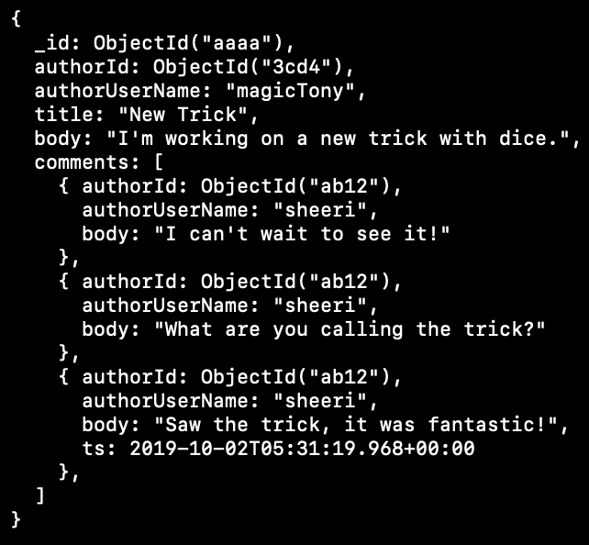
articles
Notes:
In MongoDB, you just add the new field in. You can see we added a third comment here, with a timestamp. That flexible schema, allows for polymorphic schemas. There’s no need to lock a table, there’s no need to have a space for a null field, and no need to worry about the effect of NULL in an index. And if you are adding a required field, you can update the other data as needed, without a lot of disruption.

Slide 81
Data that is accessed together should be stored together
Notes:
I’ve said a lot that data that is accessed together should be stored together. That means you have to know HOW your data is accessed. Sometimes, you run your application for a while and realize your data is being accessed differently than you thought. You want to redesign part of your schema to accommodate the way your application is being used. In the relational world, this would be hard to figure out, how do you change everything while keeping a system running?

Slide 82
Data that is accessed together should be stored together
No downtime seamless migrations
Notes:
With MongoDB, you can do no-downtime seamless migrations. A flexible schema means you can add and remove fields easily. In the relational world when we want to add, remove or change a field, we have to lock the table for however long that change takes. In the MongoDB world, you just add a field, remove a field, or change the field, document by document. You do have to code your application to manage the transition period.

Slide 83
Change strings to dates
Notes:
For example, let’s say you are storing dates as strings, but you realize you really want to store them as a date object.

Slide 84
Change strings to dates
Code application to handle strings and dates
Notes:
First, you would change your application to manage both strings and dates while in transition.

Slide 85
Change strings to dates
Code application to handle strings and dates
New data stored as dates
Notes:
New data would be stored as dates.

Slide 86
Change strings to dates
Code application to handle strings and dates
New data stored as dates
update documents one at a time
Notes:
Then, document by document, change strings to dates. When the changes are complete, you can change your code to expect only dates. The only locking is the write on a document, and remember a document in MongoDB is equivalent to a row in the relational world.
Imagine, being able to do a large migration with your only locking being the equivalent of row-level locking. That’s the power of MongoDB. You don’t have to get your schema perfect, and it’s OK if your application usage evolves.

Slide 87
articles
Notes:
For example, what happens if there’s a really popular article with a lot of comments? Something goes viral, or there’s a comment war going on.

Slide 88
16Mb document size limit
Notes:
Quick growth is a problem because documents have a size limit of 16 Mb,

Slide 89
16Mb document size limit
Hot documents
Activity hot spots
Notes:
and also because you can end up having documents with a disproportionate amount of activity on them.
Every time you retrieve the document, you’re retrieving ALL the comments. That’s a lot of space in memory, not to mention what the user interface looks like and how long it takes to load a page.

Slide 90
16Mb document size limit
Hot documents
Activity hot spots
Embed = fast access
Notes:
The tradeoff is with embedding is fast access - versus

Slide 91
16Mb document size limit
Hot documents
Activity hot spots
Embed = fast access
Large docs use
more memory
Notes:
large documents which are slow because they use more memory, and grow to the max size quickly.
So the best practice here is a TRADEOFF to what will use fewer resources – embedding, or, more than one document with references.

Slide 92
articles
Notes:
Here’s an articles document again. Let’s say our comments are growing and we want to separate them into another collection. One way to do it would be to use an array of references, like this:

Slide 93
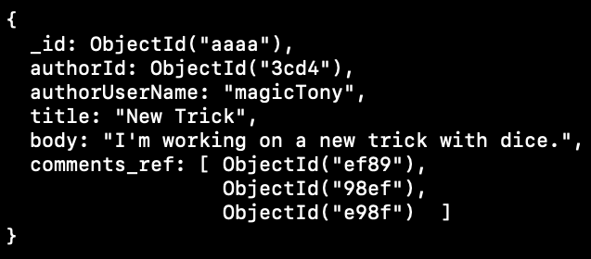
articles
Notes:
Here is an article document with an array of references to comments.

Slide 94
articles
comments
Notes:
And then the comments collection is separate. That is the natural way we think about it, coming from the relational world.
How would you do this migration without downtime? In the background, you can populate the comments collection with one document per comment. Then, also in the background, you can go through each article and add a new comments reference array.

Slide 95
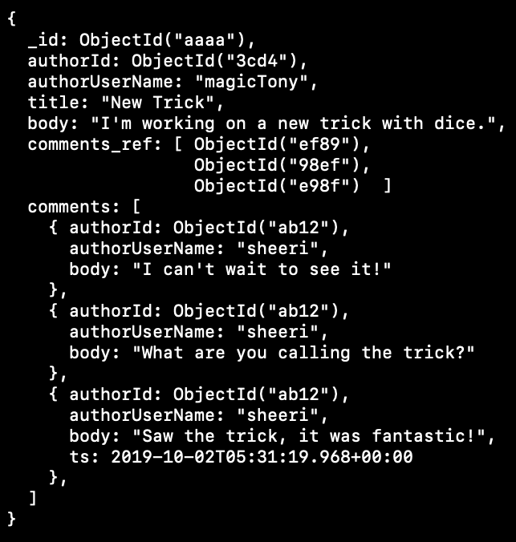
articles
Notes:
In the interim, your articles document would have a comments array with the original comments, AND a comments reference array with the references. If you have a lot of comments, you’d code your application to handle both references and embedded comments while the documents are fully populated.
This is a very relational-world style of thinking. But there are other ways to change embedded comments to optimize the tradeoff between speed and size.

Slide 96
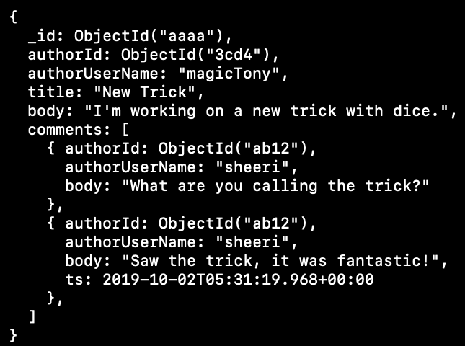
articles
Notes:
This model keeps SOME comments embedded – it could be most recent, it could be highest voted, whatever makes sense for your application. It could be the top 10, or top 100.
The important concept to note is that the embedded comments are duplicates of documents in the comments collection.

Slide 97
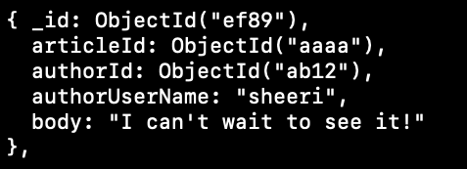
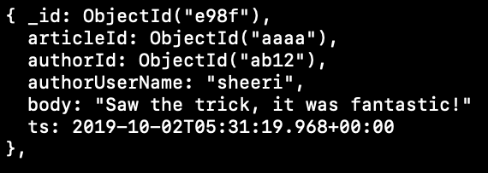
articles
comments
Notes:
So the comments collection has ALL the comments, and the comments embedded in the article documents are duplicates.
When a comment is added or updated in the comments collection, your code would check to see if it should be added into the embedded document, and if it is added, which comment should be removed. You can see that the comments now have an articleId reference, so that we can retrieve all comments on a given article.
To do this schema migration with zero downtime, you would copy all the comments into a separate collection, and then use your application logic to remove the embedded comments that shouldn’t be there. These do not need to be done across a transaction because the comments collection will contain all the comments, so your application will handle the fact that the embedded comments are duplicates.

Slide 98
articles
subset
comments
Notes:
This design pattern is called a subset pattern – because you are keeping a subset of information embedded, but you can get all the information if you need it. It’s great for comments, and also for product reviews. Anything where the display is going to show part of the data first. And that first part of the data is what’s going to be embedded, to save speed for the most common use case. Again, data that is stored together, is accessed together.

Slide 99
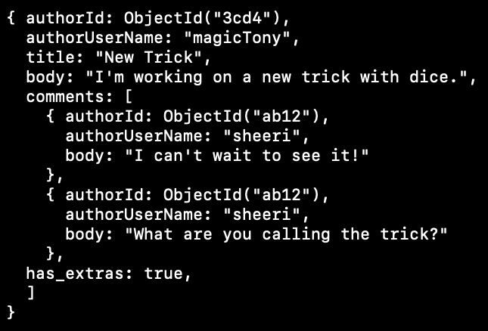
articles
Notes:
This example might seem like a variant on the subset design pattern. This record has some comments embedded, but we also see “has_extras: true” at the bottom of the document. This is a flag to tell the app that there are more comments. The use case for this is when there are only a few documents that need this overflow flag.

Slide 100
articles
overflow_comments
Notes:
And then there’s a comments collection with the overflow information. So it’s not for ONLY the top 10 comments, because many articles will have more than 10 comments. It’s more for something like people who bought a product, and if there are more than 1,000 people who bought a product, that overflow field would come into play. In this scenario, there might be 5% of the documents that have this field, not 50%. This makes it so that you can optimize for the most common use case, and an outlier does not slow your entire application down.

Slide 101
articles
outlier
overflow_comments
Notes:
This outlier pattern is very easy to migrate to without downtime. Your application needs to handle when the overflow flag exists and when it does not. There are very few records that have overflows, so you just need to find them and move the overflow data to an overflow collection.
I wanted to point out this example because when you think about the embedding vs. size tradeoff, there is not just one answer. Like the rest of schema design in MongoDB, the optimal solution depends on your usage.
Any questions before we move on to the summary?

Slide 102
Building a MongoDB schema
Notes:
The best practices for migrating your schema to mongodb are:
For 1:1 relationships, just put it in the same document, as you would put 1:1 information all in the same table in a relational system.

Slide 103
Building a MongoDB schema
Embed if you can
1:few
Notes:
For 1:many and many:many relationships, embed if you can. This was our first example with the posts and comments. You can think of it as a 1:few relationship.

Slide 104
Building a MongoDB schema
Embed if you can
1:few
Array of references for separate data 1:many
Notes:
If the data you need is separate, it’s perfectly valid to have a different collection and an array of references, instead of an array of the objects themselves. In our example, this was separating out the users to their own collection so login could get different information, such as permissions.

Slide 105
Building a MongoDB schema
Embed if you can
1:few
Array of references for separate data 1:many
Reference for unbounded arrays
1:zillion
Notes:
If you have something that grows quickly or unbounded, like log entries, or in our example, comments, it’s totally OK to use a reference. You can think of this as a 1:zillion model. But think of whether you want only references, like a relational schema, or if you want to embed some of the records.
Credit: https://www.mongodb.com/blog/post/6-rules-of-thumb-for-mongodb-schema-design-part-1

Slide 106
Schema Patterns
Polymorphic flexible schema
Notes:
So, we talked about schema patterns -
The polymorphic pattern is just our fancy name for having a flexible schema. But it’s an important pattern to get familiar with, that you can have different data without having to have any schema changes. It’s the basis for no-downtime schema migration.

Slide 107
Schema Patterns
Polymorphic flexible schema
extended reference not just _id
Notes:
The extended reference is where you keep a portion of a document embedded in the system. Our example was embedding the authorId and the authorUserName.

Slide 108
Schema Patterns
Polymorphic flexible schema
extended reference not just _id
subset part of data is duplicated by embedding
Notes:
We showed how if a collection is growing unbounded, you could use references, or you could use a subset pattern – where all of the data lives in another collection, and a subset of data is embedded in the main document.

Slide 109
Schema Patterns
Polymorphic flexible schema
extended reference not just _id
subset part of data is duplicated by embedding
outlier a few documents will overflow
Notes:
We also talked about how to optimize if most documents can embed all the data, but some cannot. This is the outlier pattern.

Slide 110
Schema Patterns
Polymorphic flexible schema
extended reference not just _id
subset part of data is duplicated by embedding
outlier a few documents will overflow
Building with Patterns blog series:
https://www.mongodb.com/blog/post/building-with-patterns-a-summary
Notes:
There are many more schema patterns in MongoDB, and I recommend taking some time to become familiar with the Building with Patterns blog series. This URL is to the summary post at the end of the series. Remember that these slides will be available after the talk, so you don’t have to worry about writing this down now.

Slide 111
From RDBMS to MongoDB
Documents do not need to have identical fields
Notes:
Most people know that MongoDB has a flexible schema. I said at the beginning that in the relational world, one of the reasons to denormalize was to make migrations easier. When you want to add a column to a table, but that table is large, instead of having a long-running ALTER TABLE, you just denormalize and make a new table.
Well, in MongoDB you do not have to choose between optimization and speed. If you want to add a new field to MongoDB, you just add it to documents, you do not need to have lengthy lock times to do so. This gives you a seamless no-downtime migration.

Slide 112
From RDBMS to MongoDB
Documents do not need to have identical fields
Data that is accessed together should be stored together
Notes:
In general, data that is accessed together should be stored together. This is a huge best practice. Think about that article schema, that had 5 tables in a relational model, and only 2 collections in MongoDB’s model, yet still gave you speed and ACID compliance. This is the reasoning behind fully or partially embedding information, even if it results in data duplication.

Slide 113
From RDBMS to MongoDB
Documents do not need to have identical fields
Data that is accessed together should be stored together
Rethink if you have lots of references or transactions
Notes:
Finally, if you find yourself making a lot of transactions, or references, that’s a sign you need to rethink your model.

Slide 114
Credit, Thanks and Links
Asya Kamsky Evin Roesle Nick Larew Aly Cabral Wikipedia
Thinking in Documents
https://www.mongodb.com/blog/post/thinking-documents-part-1
6 Rules of Thumb for MongoDB Schema Design
https://www.mongodb.com/blog/post/6-rules-of-thumb-for-mongodb-schema-design-part-1
Building with Patterns blog series:
https://www.mongodb.com/blog/post/building-with-patterns-a-summary
Notes:
I want to thank Asya Kamsky, Evin Rose-lee, Nick Larew and Aly Cabral and for their invaluable feedback. Many clarifications about relational systems came from wikipedia. And also here are the links that I posted before.

Slide 115
Q&A

