Slide 1
On Being a Senior Engineer
Sheeri Cabral
Senior Database Administrator
sheeri.cabral@salesforce.com
awfief@gmail.com
@sheeri
For an optimal experience,
make sure you can read this text.

Slide 2
Forward-Looking Statements
Statement under the Private Securities Litigation Reform Act of 1995:
This presentation may contain forward-looking statements that involve risks, uncertainties, and assumptions. If any such uncertainties materialize or if any of the assumptions proves incorrect, the results of salesforce.com, inc. could differ materially from the results expressed or implied by the forward-looking statements we make. All statements other than statements of historical fact could be deemed forward-looking, including any projections of product or service availability, subscriber growth, earnings, revenues, or other financial items and any statements regarding strategies or plans of management for future operations, statements of belief, any statements concerning new, planned, or upgraded services or technology developments and customer contracts or use of our services.
The risks and uncertainties referred to above include – but are not limited to – risks associated with developing and delivering new functionality for our service, new products and services, our new business model, our past operating losses, possible fluctuations in our operating results and rate of growth, interruptions or delays in our Web hosting, breach of our security measures, the outcome of any litigation, risks associated with completed and any possible mergers and acquisitions, the immature market in which we operate, our relatively limited operating history, our ability to expand, retain, and motivate our employees and manage our growth, new releases of our service and successful customer deployment, our limited history reselling non-salesforce.com products, and utilization and selling to larger enterprise customers. Further information on potential factors that could affect the financial results of salesforce.com, inc. is included in our annual report on Form 10-K for the most recent fiscal year and in our quarterly report on Form 10-Q for the most recent fiscal quarter. These documents and others containing important disclosures are available on the SEC Filings section of the Investor Information section of our Web site.
Any unreleased services or features referenced in this or other presentations, press releases or public statements are not currently available and may not be delivered on time or at all. Customers who purchase our services should make the purchase decisions based upon features that are currently available. Salesforce.com, inc. assumes no obligation and does not intend to update these forward-looking statements.
Notes:
Before I begin, just a quick note that you should base your purchasing decisions on products and services that are currently available.

Slide 3
Senior
vs
Junior
Notes:
Most of the time when we think “senior” we think “older”. That may be true, but a senior engineer has many qualities that usually take a lot of experience to learn, and it’s not just the field knowledge. Years of experience does not necessarily mean one is qualified for a senior role.
When we say “Senior” we usually mean a job title, like “senior engineer”. There are also other job titles, including “Junior engineer and just plain engineer.”
Image: Sheeri took this image of her mother holding her son.

Slide 4
Different Levels
Junior
Staff
Senior
Master
Lead
Guru
Fellow
I, II, III, IV, etc.
Notes:
- Promotions = formalized
categories, and levels, if you meet all the categories for that level, you get promoted.
Not # of years, usually stuff like “works by themselves with few technical questions” that come with experience.

Slide 5
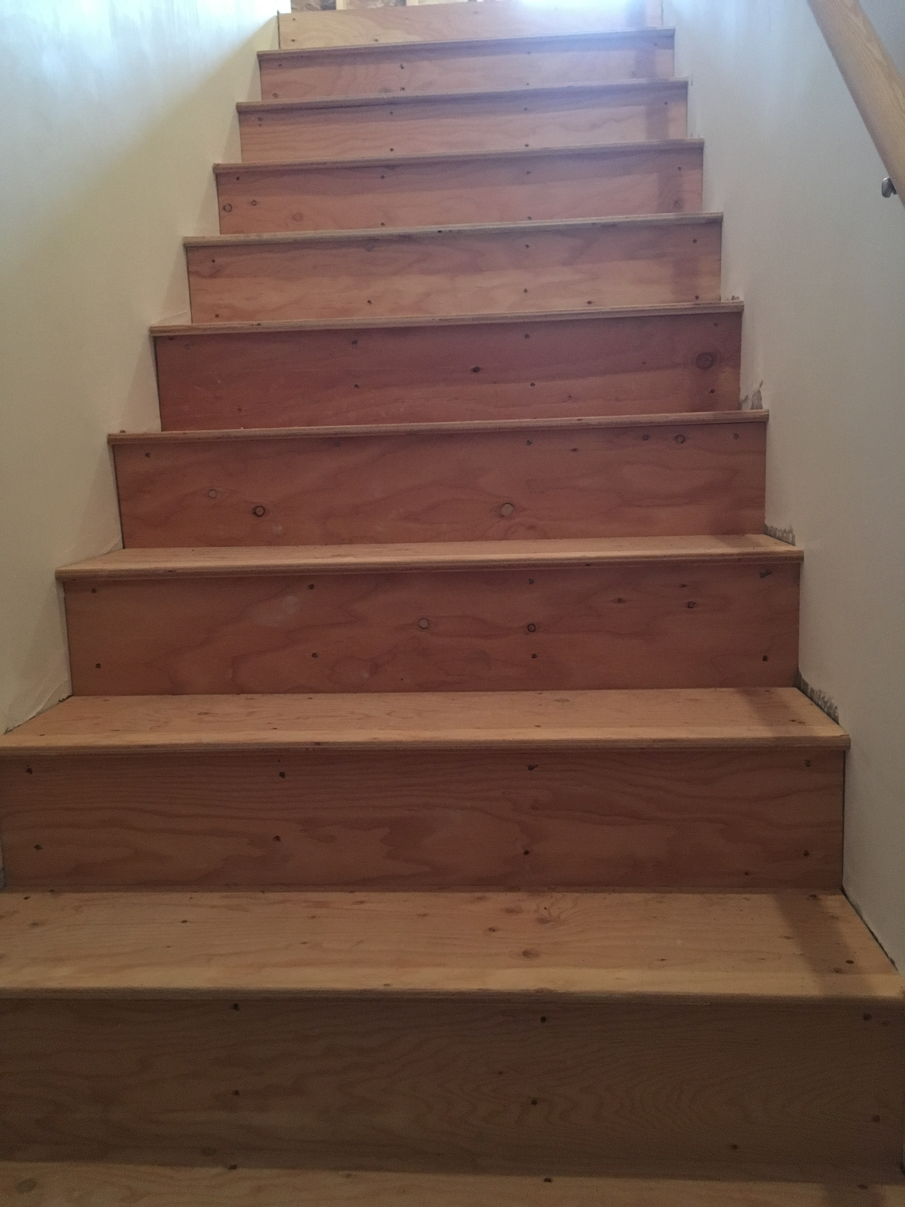
Basic Levels
Pic of a Staircase here
Executing written processes
Creating a new process and executing it
Taking initiative on a task
e.g. you see something wrong and fix it
Balance
Leading a project
…that others work on as well
Architecting an environment/large feature/product
Notes:
So, “getting it done” means different things at different levels.
A junior position may mean “follow the procedure in a timely manner”
A more senior position may mean “writing up the procedure to do it”.
If you see something, do you fix it or make a ticket for it to be fixed? Or just ignore it?
Balance - Do you make 100 tickets for every little thing or can you prioritize?
Do you pick up work when you ran out of things to do?
Do you procrastinate by checking social media and the news, or do you read industry blog posts?
Photo credit: Sheeri took this photo of her attic stairs.

Slide 6
The Work You Do
Small projects
Larger projects
Lead small/bigger projects
Participate in a project (or product)
Be part of the project specs
Define the vision for the project
Image by すじにくシチュー
https://commons.wikimedia.org/wiki/File:Work_(physics).svg
Notes:
Slide has a similar theme from previous slide
Image credit: https://commons.wikimedia.org/wiki/File:Work_(physics).svg

Slide 7
Autonomy
Constant instruction/supervision/verification
Verifies, little supervision, little instruction.
Can find answers…
… in a many places
Understanding how stuff works
Notes:
Needs help constantly
Needs help only/mostly on technologies new to the company (not just new to them)
Knows how to look for answers and will look before asking others – on your team, in your department, in your company, in your industry. Looks in a wide variety of places – not just google, stack overflow, product documentation, tickets, etc.
Understanding how stuff works so you can reason out the answer – e.g. if someone asks if you can remove an item from the middle of an array, and you know how arrays work in PHP, you can tell them.
And yet, ask for a second set of eyes. Two heads are better than one and you may be introducing tech debt.
Image credit: Sheeri took this picture of her son.

Slide 8
Second Set of Eyes
What a PR is
Two heads better than one.
Reduce (or at least identify) technical debt
Balance
Image by Wikimedia user Opoterser~commonswiki aka Thomas Shahan
https://commons.wikimedia.org/wiki/File:Phidippus_audax_male.jpg
Notes:
Balance – like we talked about, you don’t want to ask for a second set of eyes on anything. But it also shows you are open to constructive criticism and are a team player, if you ask on the right stuff.
Image credit: https://commons.wikimedia.org/wiki/File:Phidippus_audax_male.jpg

Slide 9
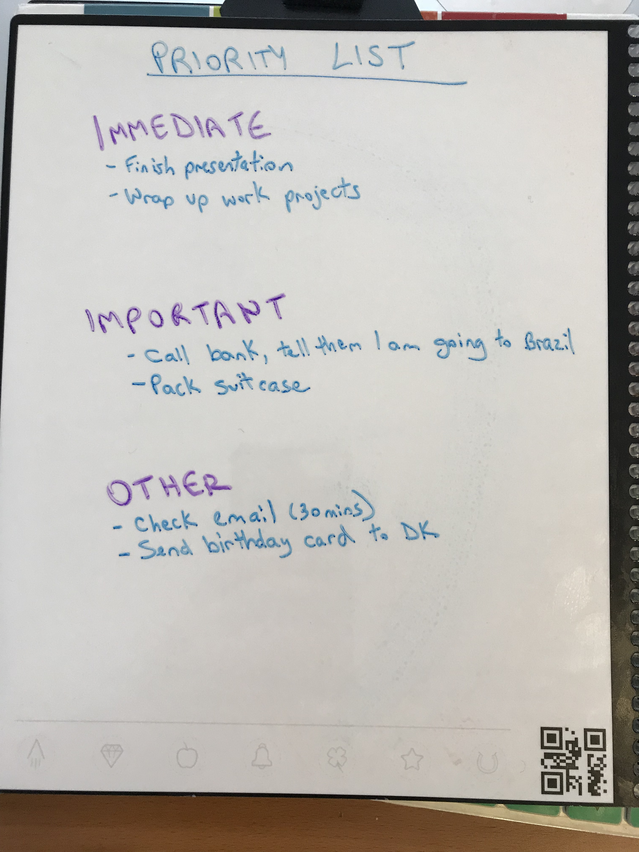
Prioritize
Needs priorities and timelines told to them
may need reminding
Always asks about priorities and timelines
“Knows” priorities
Sets priorities within a team/department/organization
Notes:
In addition to explaining priorities:
Anecdote: in chat: “Are you busy”? Well, it depends…if it’s an emergency I’m not busy. If it’s something that can wait until office hours, I’m busy.

Slide 10
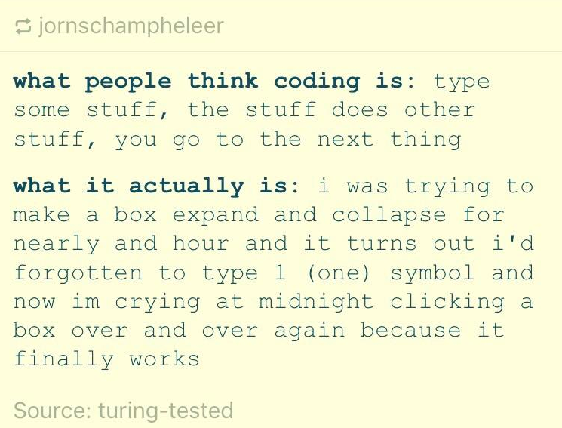
Setting and Meeting Expectations
”I’ll make sure the code is secure”
“I’ll implement the encryption module we spec’d out”.
“I’ll implement the encryption module we spec’d out by the end of May.”
Ask “What’s your timeframe on when you need this?” If they’re vague ask “do you need it today? By end of week? End of month/sprint?”
Follow-through, and follow-up.
Notes:
What doe “Done” even mean? It’s usually more than just the work: documentation, backups, any automations around it, UI or API, test cases, checked in code, stop/start or hide/show this feature, rollout/rollback plans, etc.
Setting expectations is VERY important. Other people waiting for your work may not understand you are working on 10 projects. If your manager asks you do to 2 projects, they may want you to do project 1 first, then project 2. This goes hand in hand with priorities. More senior engineers are better at balancing, and often, saying no.
Also being aware of deadlines and getting them done. As soon as you know your timeline changes, re-set expectations. So it’s not just expectations of what’s being done, but WHEN different parts will be done by.
Follow up and follow through – make sure you keep your promises, otherwise people won’t trust you. Next slide is follow-up.

Slide 11
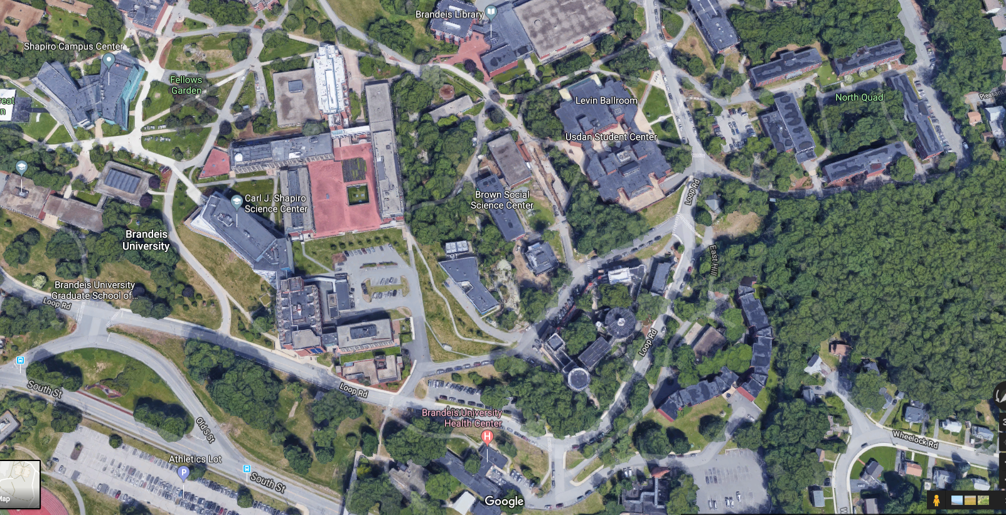
Follow Up
3
2
1
Notes:
Tell the story of how I had to really follow up on my financial aid – from the 5th floor of my dorm at #1, to the financial aid office in #2. They’d say they were waiting on the check, but the bursar’s office who gets the check is down the hill at #3. But the next day was a staff holiday – we still had classes. So on the third day I go down the hill to #3 and they say they haven’t gotten the check yet, go back to #2 to see what’s up. They don’t know. A week later, #2 tells me that the check was sent but I have to sign it, and I have to sign it at #3. That’s a lot of up and down hills.
Tip: Try to get your information the least invasive way possible, but if you need to, schedule a meeting. At the end, ask “did that answer your question?”
We talked about setting expectations, so you should theoretically know when something is “done” but follow up helps, even in the middle of a project – we’ve finished milestone X by Y deadline and now we’re working on milestone A.
Image credit – Google Satellite of Brandeis University, with added graphics by Sheeri.

Slide 12
Different Types of “No”
”I can’t do this now, but I could get it by DATE. Would that work?”
“I will ask my team if someone is available”
“If you come to office hours at X or Y, someone will be able to help you.”
If it is a private chat, simply not responding.
Notes:
Note: someone who says these ALL the time will be seen as unhelpful. Saying “no” is not the first option, but as you get more senior you will find a way to make something happen, even if you can’t do it yourself.

Slide 13
Taking and Evaluating Risks
Having an appropriate sense of risk for yourself, but also the company.
Releasing after 3 pm right before a long holiday weekend?
Weigh consequences. Makes tests and a FAST rollback plan, even if it means more work later.
e.g. disabling a user vs. deleting Disabling can be turned back on easily.
Notes:
As you become more senior you have a better sense of what kinds of risks are OK to take in the company, even if your threshold is different. If the company has a moratorium on changes, can you change dev? Dev is production for developers.

Slide 14
Trees and Forests
Doing work
Understanding the impact of the work
Understanding why the work is being done
Quarterly/yearly goals
Suggest goals
Suggest vision
Set goals/vision
Notes:
As you move up in seniority, you go from understanding your work and how it applies in the broad mission and vision of your company (usually with quarterly or yearly goals), to being someone who defines the vision for your team, department, or company.
This depends on having a level of proficiency in the technology, but also an understanding of what’s the right technology for your company, in its industry.
Image credit: A photo Sheeri took of the Stony Brook reservation

Slide 15
Recommendations
Technology, capability, organizational fit
Not just “the new tech to play with”
Caveat: Those with experience sometimes use the same old thing they are used to
Defends points when necessary.
When to fix something right away
When it is not worth fixing
When to put it in as a ticket to do later or for someone else.
Pain/time savings vs. cost. 80/20 rule.
Notes:
More senior people know when to argue to use a particular tech vs. when it does not matter. (e.g. I get asked all the time “what’s the right database for X” and really it doesn’t matter, or rather depends on the expertise you have in-house, because most databases can do most things).
From Wikipedia: The Pareto principle (also known as the 80/20 rule, the law of the vital few, or the principle of factor sparsity)^{[1][2]} states that, for many events, roughly 80% of the effects come from 20% of the causes.^{[3]}

Slide 16
Balancing: What is Best?
Sometimes the “right” technical solution is not the optimal solution for the environment.
Conversely, sometimes you go against best practice because it’s the right thing to do.
Consensus-based tech
Image by Yinan Chen
https://commons.wikimedia.org/wiki/File:Gfp-texas-big-bend-national-park-balanced-rock.jpg
Notes:
Anecdote about a BSD firewall and how that wouldn’t look good in an audit, even though it would have more capacity than a Cisco firewall and may or may not be more secure in reality.
Picard vs. Riker?
Also anecdote about images in the database – one image, 10k or less, was fine, wouldn’t bloat the db, etc.
Consensus-based tech – everyone has a voice, concerns are addressed, and you come to a solution. Once that decision is made, you are on board, even if you disagree. You don’t just do whatever you want.
Image credit: https://commons.wikimedia.org/wiki/File:Gfp-texas-big-bend-national-park-balanced-rock.jpg

Slide 17
Your Scope
Small scope/impact
Bigger scope/impact
Working with more people
…across teams
Perhaps even to customers.
Image credit:
https://pixnio.com/people/male-men/father-helps-son-focus-the-spotting-scope-for-a-closer-look
Notes:
Developers may get to meeting with customers – but when you do that you need a strong knowledge of what the system can and cannot do, as well as savvy enough to talk to real humans.
Image credit: https://pixnio.com/people/male-men/father-helps-son-focus-the-spotting-scope-for-a-closer-look

Slide 18
“Real” Work
Not always the code or commandline.
Meetings, expectations, DoD
Planning
May involve:
Spreadsheets
Project planning software
Ticket grooming
Documentation
Approval
Image credit:
https://commons.wikimedia.org/wiki/File:Brazil_R$01_2013.jpg
Notes:
A senior person knows that all this work is real and valuable.
I am giving this talk in Brazil, where the unit of currency is the “real” so this pun applies. Image credit: https://commons.wikimedia.org/wiki/File:Brazil_R$01_2013.jpg

Slide 19
Relationships
You work together with others to get results.
Good communication, expectations, follow-up and follow-through on promises
Talk about your hobby, what you did over the weekend, etc.
There’s a balance between being a slacker and being 100% work-focused.
Communication depends on your audience.
Different parties want different information
…At their level.
Image credit:
https://pixabay.com/en/family-friends-community-group-1921637/
Notes:
A senior person also knows that building good relationships is important. Yes, there are a lot of senior people that do not work on this, but it’s easier to get stuff done if you have a good relationship with folks. It is not a very mature attitude to talk about “politics” and “favoritism” and “just want to work on the tech”. Results matter, and if you ever work with another human being, relationships matter, too.
As for talking about fun stuff, don’t do it in a bad time/place (during an emergency)

Slide 20
Audience
Team: I have updated the settings so that the app now uses LDAP authentication.
Other tech folks: The app now uses LDAP authentication. What this means for you is that when you login to production, you have to use your LDAP username and password.
If you change your LDAP password the app will automatically pick it up.
Now you do not have to remember more than one password!
Image credit:
https://commons.wikimedia.org/wiki/File:People_in_small_discussion_group_meeting.jpg
Notes:
If you constantly give too much tech information to others, they may learn and love it, or they may be confused and not want to talk to you because you always talk in jargon. More importantly different roles want to know different impacts – a CEO or CTO cares a lot that everything is more secure, and in bigger companies may not login to that particular app.

Slide 21
Audience
All Company: Hate having to remember your app password? Now, when you login to app, you will use your single-sign on username and password.
If you have any questions, please do not hesitate to contact me or my team, in X chat channel, and our office hours are Y.
action item/knowledge
CEO/CTO: We have made the app more secure by tying it into our existing authentication mechanisms
overview
Image credit:
https://commons.wikimedia.org/wiki/File:People_in_small_discussion_group_meeting.jpg
Notes:
If you constantly give too much tech information to others, they may learn and love it, or they may be confused and not want to talk to you because you always talk in jargon. More importantly different roles want to know different impacts – a CEO or CTO cares a lot that everything is more secure, and in bigger companies may not login to that particular app.

Slide 22
Responding to a Question
“How can I get the DB to use an index on this case-sensitive query?”
“I don’t know”.
“You can’t do it”.
“You could try this, oh wait, that doesn’t work. You could try that, that’s closer, but oh that doesn’t work either.”
“Let’s hop in a call and work it out.”
“You can’t do it because a case-sensitive index puts A and a 25 letters apart whereas a case-insensitive one puts them next to each other/equal weight”
?
Notes:
What kind of person are you? Do you write or say your every thought? Do you quietly think about it and just give the answer?
What is your signal-to-noise ratio?
But you also want to let the person know you’re thinking about it, so you can’t be totally silent.
(Question mark is literally a text ? made big and purple)

Slide 23
Communication
?
Try using WHERE foo=‘Foobar” AND foo=‘Foobar’ collate utf8_bin; and see if it still uses an index.
I tested WHERE foo=‘Foobar” AND foo=‘Foobar’ collate utf8_bin; and it still uses an index, so you can do that.
“What is the problem you are trying to solve?”
Think about who is asking the question.
Think about what is going on.
Notes:
Often when someone asks to do something complicated, it is because they are solving a different problem and that is one piece of the puzzle. Sometimes it’s worth it to take a step back and ask what the bigger picture is – this is something good senior people do. But of course, balance, not all the time.
If your boss asks you to do something, you do it. If your boss says “I’d be interested to see X” also do it.
Are you jumping in to help others? Is what you are going to say, the same thing anyone would say? This falls under the “signal-to-noise ratio” idea.
Also, if there are multiple conversations going on, a senior person will separate them. Especially if one of the conversations involves an emergency.

Slide 24
Reputation
People perceiving you as an expert
Relationships
Trust – follow through and follow up
Do a good job, even on jobs you think are beneath you
Help others
Notes:
This goes hand in hand with relationships – people are more likely to view you as an expert if you’re easy to talk to, and give explanations for your decisions, than if you just say “X is right and that’s final, you don’t understand!”
Doing a good job even on trivial work means you’re building small amounts of trust. Especially if you’re trying to get farther in the ranks. But nobody likes someone with an ego.
Help others – be a force multiplier, rise all the boats.

Slide 25
Tips and Tricks
Develop relationships
Thank people who do work for you and with you.
If a big project finishes or someone leaves the company, write a nice LinkedIn review.
Make it easy for others to do what you need them to do
Notes:
Put asks at the top of an email or a tl;dr summary. Use phrases like “what this means for you” and “action item:”
Meeting recaps are great.
Setting expectations, Ask them what you want them to do up front, and ask for a timeframe right away. E.g. “can you look over this project plan and send me back comments by end of day Monday? I want to make sure I am not missing any steps.”
Helps you keep record too – “I have been waiting forever!” but you realize it’s only been a few days.

Slide 26
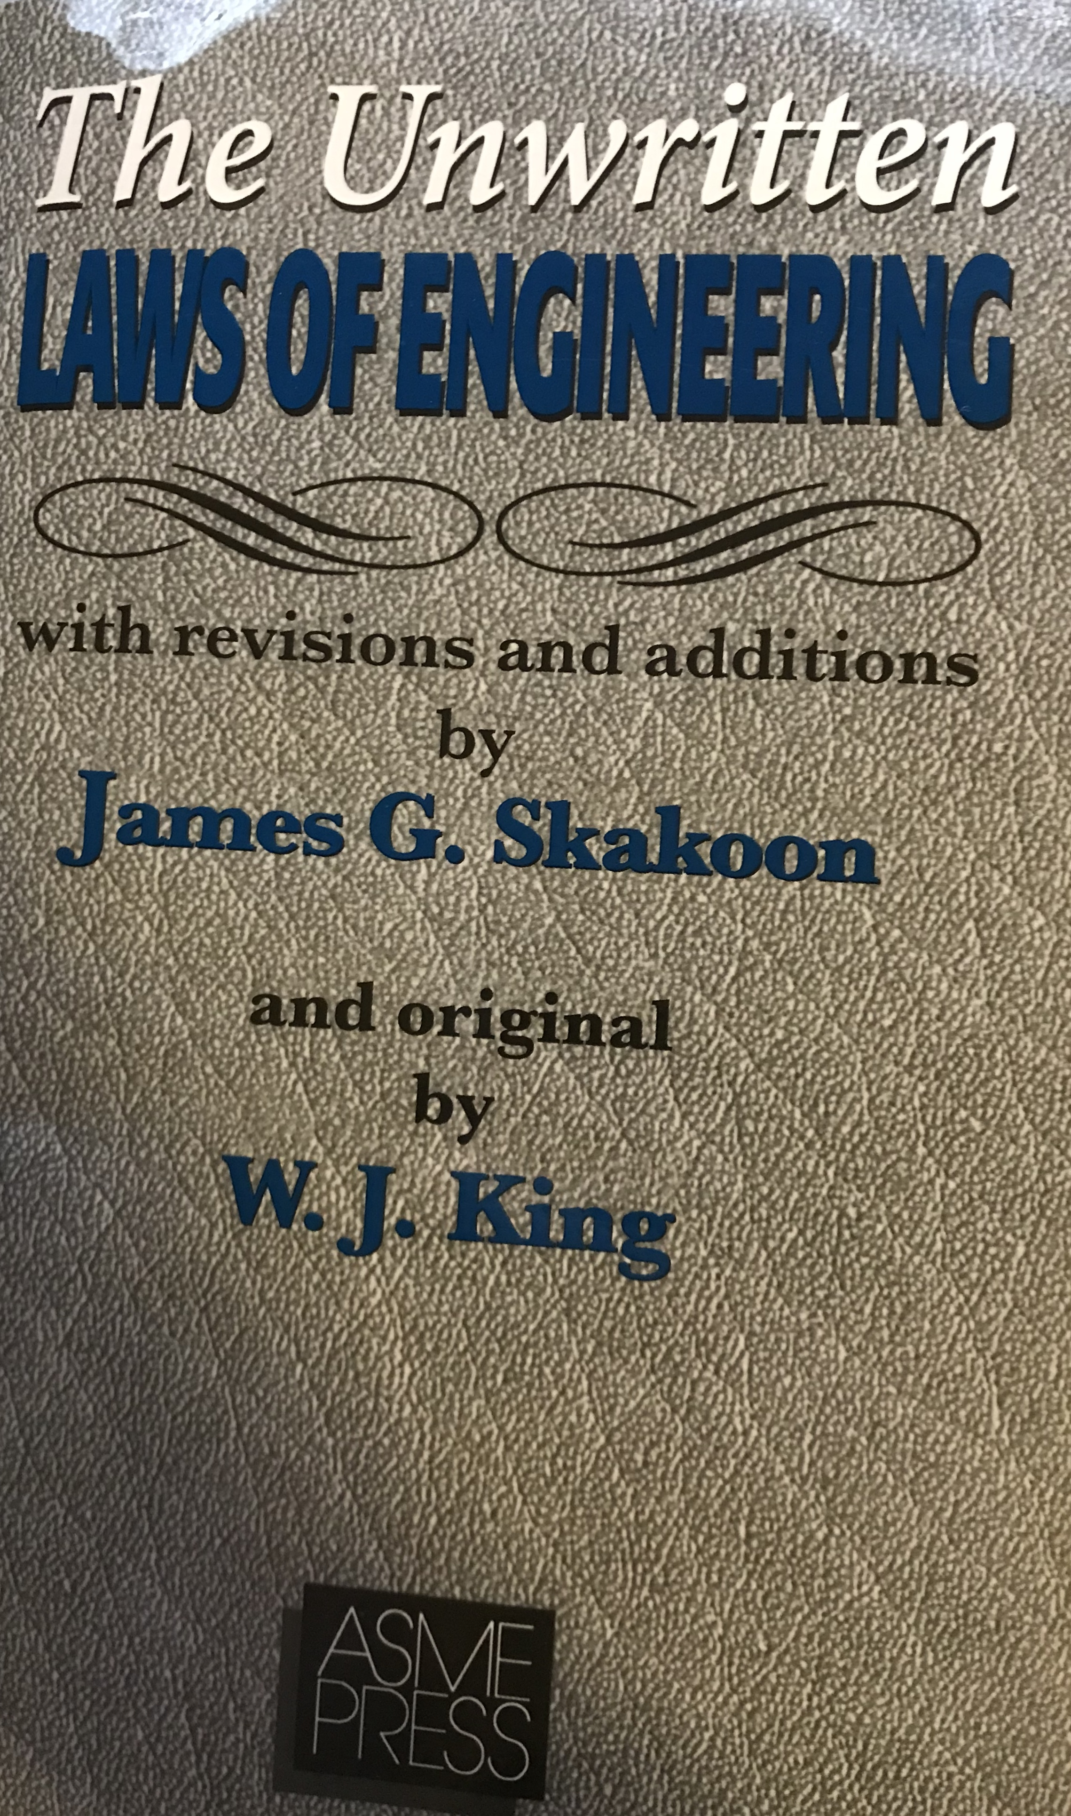
Further Study
The Unwritten Laws of Engineering - http://tlmerrill.pbworks.com/w/file/fetch/85018306/Unwritten%20Laws%20Engineering.pdf
John Allspaw’s “On Being a Senior Engineer” which includes “The Ten Commandments of Egoless Programming”. https://www.kitchensoap.com/2012/10/25/on-being-a-senior-engineer/
Notes:
The Unwritten Laws of Engineering is a very short book, it’s just 3 essays, originally printed in the journal the American Society of Mechanical Engineers. Some of the information is outdated, including assuming all engineers are men, but a surprising amount is still relevant.
Image credit: I took a picture of my copy of the book.

