Slide 1
Data Integration:
Getting
Different Data Sources
To Talk To Each Other
Sheeri Cabral
Data Team Manager, Mozilla
@sheeri

Slide 2
What is data integration?
Notes:
And where is it already being used? E.g. data exports from production to stage
Been doing data agg for a long time, within data team and outside Hand-coded ETL, rollups, aggregations
Anything that gets data from one place to another, mysql to mysql, hadoop to vertica, etc.

Slide 3
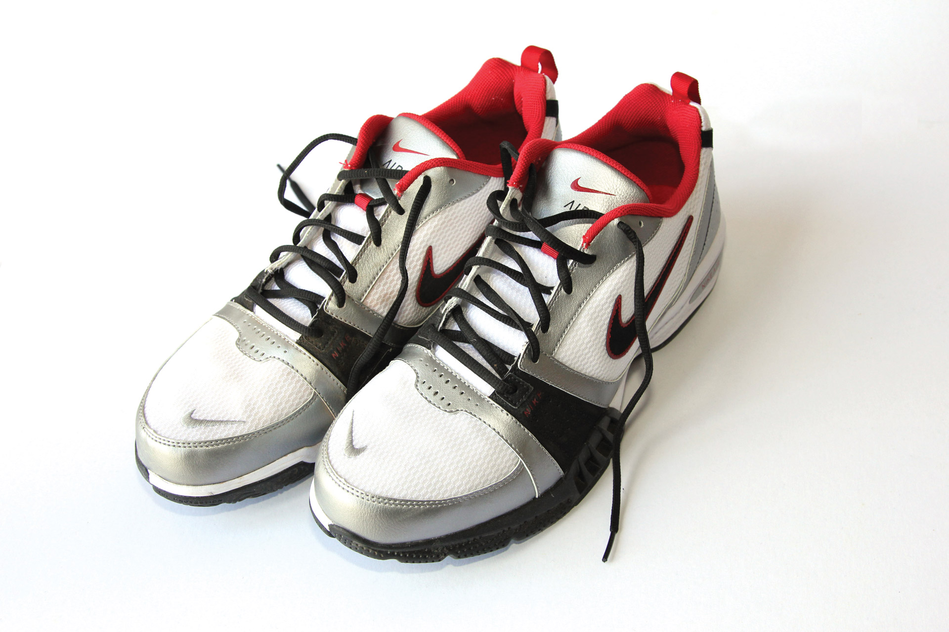

Slide 4
Notes:
The next generation of data integration

Slide 5
Current Issues
Very manual process
Coding involved
Incomplete APIs
Notes:
Manual process – can be automated, but every integration is a special flower. How does it launch? Application? Cron job? How is that being monitored? No unified monitoring or process.
Coding involved – not everyone has time to code, and not everyone CAN code.
Even if you can and have time to code, sometimes you can't get what you want from an API, or an API doesn't exist.

Slide 6
Example
A reorg changes a lot:
Cost center
Managers
Egencia
Expensify
Phonebook
Notes:
About a dozen places things need to be changed and they do it manually

Slide 7
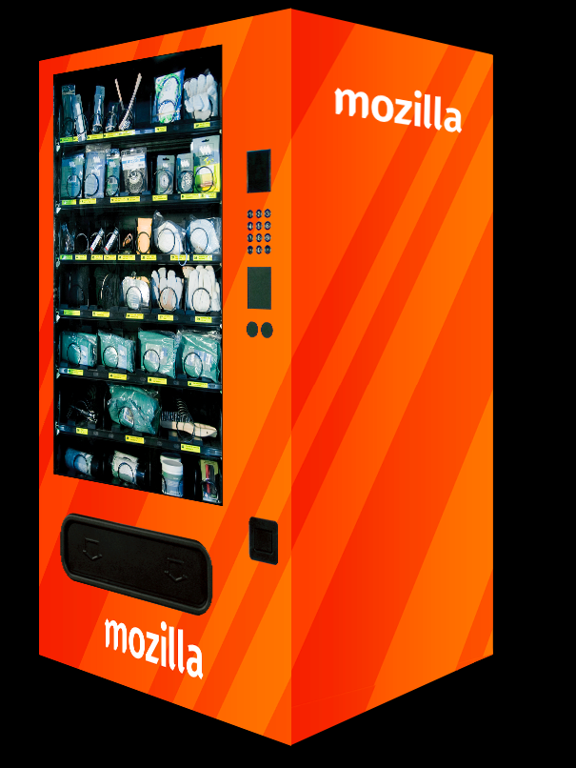
More Complex Example
Notes:
Vending machine – needs badge info from ccure, but also needs department info. Some people have badges that shouldn't be allowed to access this, like the people stocking the fridges. So, from ccure -> IVM
Then, the info needs to go from the vending machines to servicenow, for accounting purposes.

Slide 8
Centralized Data Integration
NOT Mandatory
Data flows THROUGH the platform
Data is NOT SAVED inside the platform
Goals:
Unified production platform
Outsource tech work to the Data Team
Coding/db familiarity unnecessary
Easy plugin to graphing
Notes:
Unified production platform - backed up, monitored, centralized ops
Outsource – still need biz work from you
Easy plugin to graphing – tableau, your own source, etc. Easily connects with data warehouse, etc.

Slide 10
DB Connectors
MySQL
Postgres
Vertica
Amazon Redshift
Any ODBC/JDBC data store
Notes:
Connector is needed to connect to a source or target and retrieve or upload information

Slide 11
App Connectors
Google Apps
Hadoop
JIRA
Quickbooks
Salesforce
Workday
Intacct
…and more

Slide 12
Tech Connectors
HTTP
SFTP
LDAP
SOAP
REST

Slide 13
Powerful ETL interface

Slide 14
Can You Do…..?
Yes.
No really. Yes.
Seriously, yes.

Slide 15
Worst Case Scenario
Generate source reports, upload to SFTP server
Boomi gets from SFTP server, does ETL
Boomi uploads to SFTP server
Target retrieves and imports

Slide 16
Data Team and Integration
Integration is a key middle point between:
Databases and Data Warehouses
Cloud/SaaS apps and Dashboards

Slide 17
Data Team and Integration
Shraddha Patil – spatil@mozilla.com
Data team – data@mozilla.com

Slide 18
Questions? Comments?

